Slide 1
/storage/emulated/0/Download/Employee-Performance-Analysis-Leveraging-Excel-for-Data-Driven-Insights.pptx
NAME:B.DHANUSH KUMAR
REGISTER NO:122201512
DEPARTMENT:B.COM(C.S)
COLLEGE :PACHAIYAPPA’S COLLEGE

Slide 2


Employee Performance Analysis: Leveraging Excel for Data-Driven Insights
In today's competitive business environment, organizations are constantly seeking ways to enhance productivity, optimize resource allocation, and drive growth. Employee performance analysis plays a pivotal role in achieving these objectives, providing valuable insights into individual and team performance, enabling effective decision-making, and fostering a culture of continuous improvement. This presentation delves into the utilization of Microsoft Excel, a powerful and versatile tool, for conducting comprehensive employee performance analysis. We will explore the various techniques and functionalities available within Excel that empower organizations to gain a deeper understanding of employee contributions, identify areas for development, and ultimately, foster a high-performing workforce.
by Giri prasad D.S

Slide 3

Project Overview
This project aims to leverage the capabilities of Microsoft Excel to analyze employee performance data. We will be working with a dataset containing key metrics and indicators that reflect employee contributions and overall effectiveness. These metrics might include sales figures, customer satisfaction scores, project completion times, attendance records, and performance reviews. By utilizing Excel's built-in functions, formulas, and data visualization tools, we will be able to extract meaningful insights from the raw data, identify trends, and develop actionable recommendations for improving employee performance.
1
Data Collection
2
Data Cleaning and Preparation
Gathering accurate and comprehensive data is the cornerstone of any effective analysis. We will ensure that the dataset we utilize encompasses relevant metrics that provide a holistic view of employee performance.
Before analysis, we will thoroughly clean and prepare the data to ensure its accuracy, consistency, and suitability for analysis. This involves identifying and addressing any inconsistencies, missing values, or outliers that might skew the results.
3
Data Visualization
4
Actionable Insights
We will employ various data visualization techniques to present the analysis findings in a clear, concise, and visually appealing manner. Charts, graphs, and dashboards will be utilized to effectively communicate insights and trends to stakeholders.
The ultimate goal is to derive actionable insights from the analysis. These insights will form the basis for recommendations on employee development, performance improvement initiatives, and resource allocation strategies.

Slide 4
End Users
The primary end users of this employee performance analysis are the Human Resources (HR) department, managers, and team leaders. These stakeholders have a vested interest in understanding employee performance, identifying areas for improvement, and fostering a high-performing culture. The insights derived from the analysis will empower HR to develop targeted training programs, managers to provide constructive feedback, and team leaders to allocate resources effectively.
HR Department
Managers
Team Leaders
The HR department utilizes the insights from the analysis to develop and implement HR strategies that support employee growth, optimize talent acquisition and retention, and ensure compliance with labor laws and regulations.
Managers rely on performance analysis to track the progress of their team members, identify areas where coaching and mentoring are required, and provide constructive feedback to foster individual development and growth.
Team leaders use the analysis to assess the performance of their teams, identify bottlenecks, and allocate resources effectively. They can also use the data to recognize and reward high-performing team members.

Slide 5

Our Solution and Proposition
Our solution involves leveraging the power of Microsoft Excel to analyze employee performance data. We will utilize a combination of Excel's built-in functions, formulas, and data visualization tools to extract meaningful insights from the data. Our proposition offers a data-driven approach to employee performance analysis, providing valuable insights that empower organizations to make informed decisions, drive improvement initiatives, and foster a high-performing workforce.
Data-Driven Approach
Actionable Insights
We prioritize a data-driven approach, using quantifiable metrics and objective analysis to gain insights into employee performance.
We focus on generating actionable insights that can be translated into concrete strategies for improving employee performance and organizational effectiveness.
Cost-Effective Solution
Ease of Implementation
Excel is a readily available and cost-effective tool, making our solution accessible to organizations of all sizes.
Our approach is straightforward and easy to implement, requiring minimal technical expertise.

Slide 6
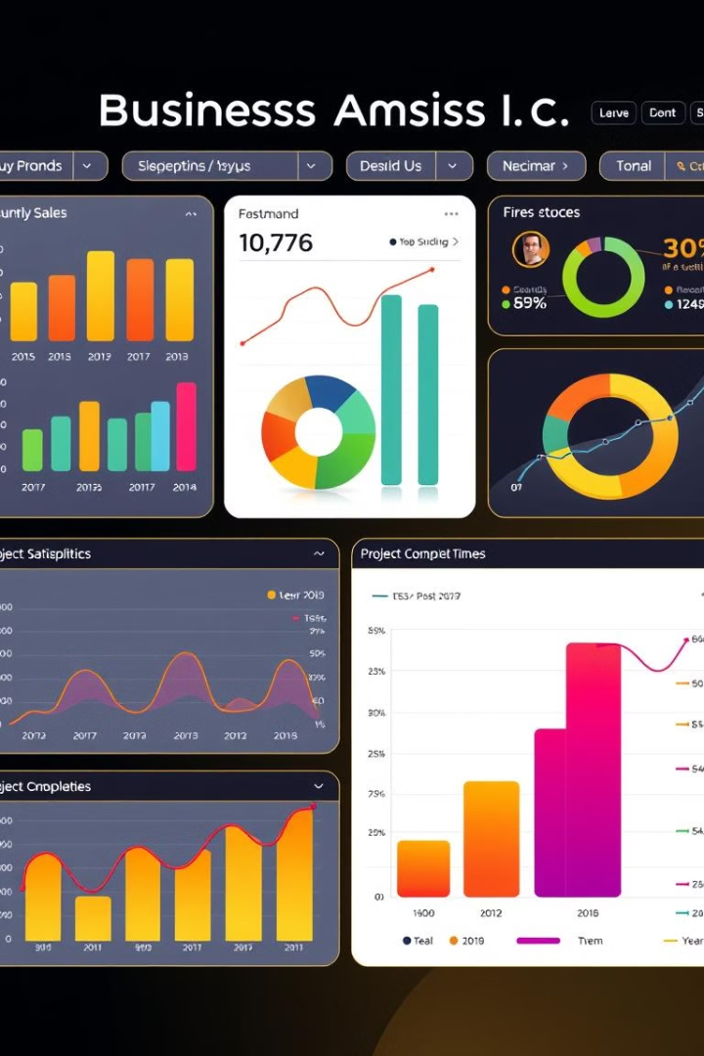
Dataset Description
The dataset for this employee performance analysis consists of a comprehensive set of data points related to employee performance. The dataset is organized in a tabular format, with each row representing an employee and each column representing a performance metric. The metrics included in the dataset are carefully selected to provide a holistic view of employee contributions and effectiveness. These metrics may encompass various aspects of employee performance, such as sales figures, customer satisfaction scores, project completion times, attendance records, and performance reviews.
Metric
Description
Sales Figures
Quantifies the revenue generated by each employee.
Customer Satisfaction Scores
Measures the level of customer satisfaction with each employee's service or product.
Project Completion Times
Tracks the time taken to complete projects assigned to each employee.
Attendance Records
Records the frequency and regularity of employee attendance.
Performance Reviews
Captures qualitative assessments of employee performance provided by supervisors or peers.

Slide 7

Modelling Approach
The modelling approach for this employee performance analysis involves utilizing Excel's powerful functions and formulas to analyze the dataset and derive meaningful insights. We will leverage Excel's capabilities to perform calculations, generate statistical summaries, and create visualizations that reveal patterns and trends in the data. The goal is to develop a model that can accurately predict employee performance, identify areas for improvement, and provide insights that support organizational decision-making.
1
Data Cleaning and Preparation
The first step involves cleaning and preparing the data to ensure its accuracy, consistency, and suitability for analysis. This includes identifying and addressing any missing values, outliers, or inconsistencies in the data.
2
Descriptive Statistics
We will calculate descriptive statistics such as mean, median, mode, standard deviation, and percentiles to understand the central tendency, dispersion, and distribution of the data.
3
Regression Analysis
Regression analysis will be used to identify the relationship between employee performance metrics and other factors that may influence performance, such as experience, education, and training.
4
Data Visualization
Various data visualization techniques will be employed to present the analysis findings in a clear, concise, and visually appealing manner. Charts, graphs, and dashboards will be used to communicate insights and trends effectively.

Slide 8
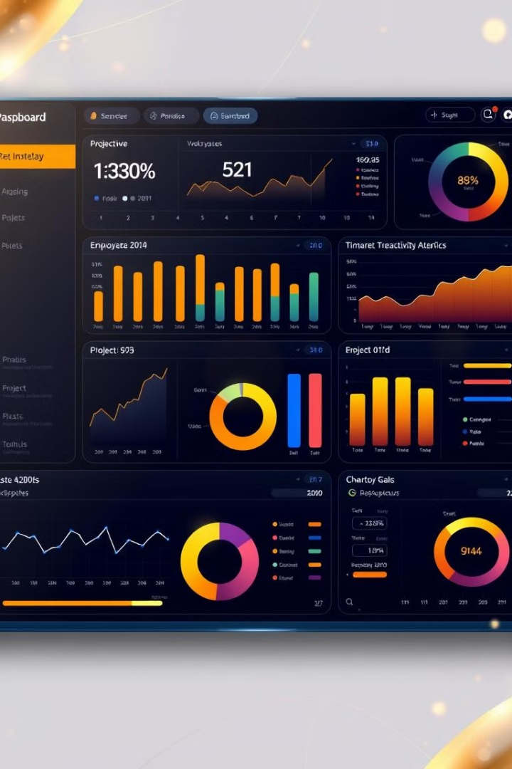




Results
The results of the employee performance analysis will reveal insights into individual and team performance, highlighting areas of strength and weakness. The analysis will identify trends, patterns, and correlations in the data, providing a comprehensive understanding of employee contributions and effectiveness. The findings will be presented in a clear and concise manner, utilizing a combination of tables, charts, and graphs to effectively communicate the insights to stakeholders.
Overall Performance
The analysis will provide an overall assessment of employee performance, highlighting areas where the workforce excels and areas that require improvement.
Individual Performance
The results will shed light on the performance of individual employees, identifying their strengths, weaknesses, and areas for development.
Team Performance
The analysis will examine the performance of teams, identifying areas of collaboration and synergy, as well as potential bottlenecks or areas for improvement.
Trends and Patterns
The analysis will uncover trends and patterns in the data, revealing insights into the factors that drive employee performance and the impact of various initiatives on employee effectiveness.

Slide 9





Discussion
The discussion phase of the employee performance analysis is critical for interpreting the results, drawing conclusions, and generating actionable recommendations. This involves collaborating with stakeholders from HR, management, and team leadership to analyze the insights revealed by the analysis, identify the root causes of any performance issues, and formulate strategies for improvement. The discussion will focus on translating the data-driven insights into practical solutions that can be implemented to enhance employee performance and drive organizational success.
Identifying Root Causes
Generating Actionable Recommendations
The discussion will delve into the root causes of any performance issues identified by the analysis, exploring factors such as training gaps, lack of motivation, inadequate resources, or ineffective communication.
Based on the insights and root cause analysis, the discussion will generate actionable recommendations for improving employee performance, such as tailored training programs, performance improvement plans, or changes to work processes.
Collaborative Approach
Focus on Continuous Improvement
The discussion will foster a collaborative environment, encouraging input from HR, managers, and team leaders to ensure that the recommendations are practical, aligned with organizational goals, and supported by all stakeholders.
The discussion will emphasize the importance of continuous improvement, recognizing that employee performance analysis is an ongoing process that requires regular monitoring, evaluation, and adaptation.

Slide 10

Conclusion
In conclusion, the employee performance analysis conducted using Microsoft Excel provides a powerful and effective tool for gaining insights into individual and team performance, identifying areas for improvement, and driving organizational success. By utilizing Excel's functions, formulas, and data visualization tools, we can extract meaningful insights from the data, generate actionable recommendations, and foster a culture of continuous improvement. The analysis empowers HR, managers, and team leaders to make data-informed decisions, optimize talent utilization, and create a high-performing workforce.
1
Data-Driven Decision Making
2
Continuous Improvement
3
High-Performing Workforce
Employee performance analysis provides a data-driven foundation for making informed decisions related to employee development, resource allocation, and performance improvement initiatives.
The analysis is an ongoing process that requires regular monitoring, evaluation, and adaptation to ensure that performance improvement efforts are aligned with changing business needs and organizational goals.
By leveraging the insights from the analysis, organizations can foster a culture of continuous improvement, empower employees, and cultivate a high-performing workforce that drives organizational success.

Slide 11

Author Information
This employee performance analysis project was conducted by D.S.GIRI PRASAD, a student in the B. COM (C.S) program at PACHAIYAPPA'S COLLEGE. His passion for data analysis and his expertise in Microsoft Excel have enabled him to develop this comprehensive analysis, providing valuable insights for organizations seeking to optimize employee performance and drive growth.

